Slide 1
DETECTION OF FUNGAL DISEASES USING LEAF IMAGES THROUGH CNN
TEAM MEMBERS:
1. RAHUL J (953120104039)
2. THANGAPPAN N (953120104054)
3. SRIMAN BALA GANESH M (953120104304)
GUIDED BY
Dr. J. ARMSTRONG JOSEPH, M. E., Ph. D., HOD/CSE

Slide 2
CONTENTS
Abstract
Objective
Introduction
Literature Survey
Hardware and Software Requirements
Existing System
Detailed Design
Problem Statement

Slide 3
CONTENTS (CONTD.)
Proposed System
System Architecture
List of Modules
Results Obtained
Conclusion
References

Slide 4
ABSTRACT
Plant diseases harm plants, reducing crop yields. Detecting them early is crucial. This study targets fungal diseases such as rust and powdery mildew. Using Conv-9 CNN (Convolutional Neural Network), we aim to develop a method for accurate disease identification based on leaf images. By training Conv-9 CNN with datasets, they learn to recognize disease. This empowers farmers to act quickly, preventing disease spread and improving agricultural sustainability.

Slide 5
OBJECTIVE
Develop an accurate and efficient automated system for identifying fungal diseases based on leaf images.
Utilize CNN to enable early detection of fungal diseases such as rust and powdery mildew.
Promote sustainable farming practices through the adoption of advanced technology for fungal disease detection in plants.

Slide 6
INTRODUCTION
Rust and powdery mildew are common fungal leaf diseases affect agricultural productivity and food security.
Early detection is crucial for minimizing crop yield impact. Advances in artificial intelligence, particularly computer vision, offer promising solutions for automated disease detection.
This study investigates using custom CNN for rust and powdery mildew identification, aiming to enhance agricultural sustainability and food security.

Slide 7
LITERATURE SURVEY
Table 1. Literature Survey for detection of fungal diseases using leaf images through CNN.
Sl. No. | AUTHOR NAME | YEAR | TITLE | METHOD/ ALGORITHM | TOOLS
1. | Vibhor Kumar Vishnoi, Krishan Kumar, Brajesh Kumar, Shashank Mohan, Arfat Ahmad Khan. | January 2023 | Detection of Apple Plant Diseases Using Leaf Images Through Convolutional Neural Network | Conv-3 DCNN architecture, Adam optimization algorithm. | OpenCV

Slide 8
LITERATURE SURVEY (CONTD.)
Table 2. Literature Survey for detection of fungal diseases using leaf images through CNN.
Sl. No. | AUTHOR NAME | YEAR | TITLE | METHOD/ ALGORITHM | TOOLS
2. | Lili Li, Shujuan Zhang, Bin Wang. | April 2021 | Plant Disease Detection and Classification by Deep Learning | Deep Learning | TensorFlow, Keras, PyTorch, and OpenCV.

Slide 9
LITERATURE SURVEY (CONTD.)
Table 3. Literature Survey for detection of fungal diseases using leaf images through CNN.
Sl. No. | AUTHOR NAME | YEAR | TITLE | METHOD/ ALGORITHM | TOOLS
3. | Peng Jiang, Yuehan Chen, Bin Liu, Dongjian He, Chunquan Liang. | May 2019 | Real-Time Detection of Apple Leaf Diseases Using Deep Learning Approach Based on Improved Convolutional Neural Networks | Improved Neural Network with Rainbow Concatenation and Single Shot Detector (INAR-SSD) | OpenCV

Slide 10
HARDWARE AND SOFTWARE REQUIREMENTS
HARDWARE REQUIREMENTS
RAM : Minimum 4 GB
Processor : Intel core i3 or later
Hard Disk : Minimum 40 GB
SOFTWARE REQUIREMENTS
Operating System : Windows 10 or later
Language : Python 3.11
Software : Jupyter Notebook

Slide 11
EXISTING SYSTEM
The existing technique employs a Conv-3 CNN architecture, featuring three convolutional layers, two fully connected layers, and a dropout layer.
It utilizes the Adam (Adaptive Moment Estimation) optimization algorithm for efficient parameter optimization. This method swiftly identifies apple diseases like scab, black rot, and cedar rust.
However, its suitability is confined to apple plants, necessitating tailored models for other plant species.

Slide 12
PROBLEM STATEMENT
Pathogenic fungi cause plant diseases like rust and powdery mildew. Effective detection and classification of these diseases from leaf images are crucial for agricultural management.
Leveraging CNN for automated identification faces challenges such as diverse environmental conditions and leaf variations.
This project aims to develop a robust CNN-based system for accurate fungal disease detection and classification in plants.

Slide 13
PROPOSED SYSTEM
This system aims to detect healthy plants and those with rust and powdery mildew.
Focusing on normal green leaves, it utilizes image analysis and machine learning to develop a robust model.
Using a Conv-9 CNN architecture and the Adam optimization algorithm, it accurately identifies plant health based on leaf color and texture features.

Slide 14
SYSTEM ARCHITECTURE
Data gathering
Test data
Preprocessing
Preprocessing
Train CNN model
CNN based prediction
Healthy
Powdery mildew
Rust
Fig 1. The system architecture for detection of fungal diseases using leaf images through CNN.

Slide 15
DETAILED DESIGN
Data Gathering:
Data collection involves gathering raw data, such as images of plant leaves with disease symptoms.
Collecting images of both healthy plants and plants with rust and powdery mildew symptoms is an essential part of data collection for building a plant disease recognition system.

Slide 16
DETAILED DESIGN (CONTD.)
Preprocessing:
Image preprocessing involves preparing images for input into a machine learning model. Common preprocessing steps include resizing and normalization.
Resizing ensures uniformity in image dimensions, normalization scales pixel values to a standard range. These steps enhance model performance and generalization.

Slide 17
DETAILED DESIGN (CONTD.)
Train CNN model:
Training using CNN involves iteratively optimizing network parameters through forward and backward passes, adjusting weights based on loss calculated from predicted and actual outputs.
The trained model is the output of the training process where a CNN has learned to recognize patterns and features in the training data.

Slide 18
DETAILED DESIGN (CONTD.)
Train CNN Model:
Convolution Layer
Max Pooling Layer
Flatten Layer
Dense Layer
Dropout Layer
Fig 2. Train CNN model architecture

Slide 19
DETAILED DESIGN (CONTD.)
Train CNN Model → Convolution Layer:
Input(Preprocessed Image)
Filters
Convolution Operation
Convolution Layer
Activation Function (ReLU)
Output Feature Maps
Max Pooling Layer
Fig 3. Convolution layer architecture

Slide 20
DETAILED DESIGN (CONTD.)
Convolution Layer:
The input volume represents the initial data fed into the convolutional layer, such as an image.
The convolutional layer consists of multiple filters (kernels), each applied to the input volume to produce feature maps.
The convolution operation involves sliding each filter across the input volume and computing dot products to generate feature maps.

Slide 21
DETAILED DESIGN (CONTD.)
Convolution Layer (Contd.):
An activation function (e.g., ReLU) is applied to introduce non-linearity into the feature maps.
The output feature maps represent the final output of the convolutional layer, containing extracted features from the input data.

Slide 22
DETAILED DESIGN (CONTD.)
Train CNN Model → Max Pooling Layer:
Input Feature Maps
Max Pooling Layer
Max Pooling Operation
Output Pooled Feature Maps
Flatten Layer
Fig 4. Max pooling layer architecture

Slide 23
DETAILED DESIGN (CONTD.)
Max Pooling Layer:
The input to the max pooling layer consists of feature maps generated by the previous convolutional layer.
The max pooling layer performs max pooling operations on each feature map independently.
Max pooling involves dividing each feature map into non-overlapping rectangular regions (e.g., 2x2 or 3x3) and taking the maximum value within each region.

Slide 24
DETAILED DESIGN (CONTD.)
Max Pooling Layer (Contd.):
The output of the max pooling layer consists of pooled feature maps with reduced spatial dimensions, obtained by downsampling the original feature maps.

Slide 25
DETAILED DESIGN (CONTD.)
Train CNN Model → Flatten Layer:
Input Feature Maps
Flatten Layer
Flattening Operation
Output Feature Vector
Dense Layer
Fig 5. Flatten layer architecture

Slide 26
DETAILED DESIGN (CONTD.)
Flatten Layer:
The input to the flatten layer consists of feature maps generated by the previous convolutional or pooling layer.
The flatten layer performs a flattening operation, which reshapes the multi-dimensional feature maps into a one-dimensional feature vector.

Slide 27
DETAILED DESIGN (CONTD.)
Flatten Layer (Contd.):
The output of the flatten layer is a feature vector, which is a one-dimensional representation of the spatial features extracted from the input data.
This flattened representation is typically used as input to fully connected layers for further processing and classification.

Slide 28
DETAILED DESIGN (CONTD.)
Train CNN Model → Dense Layer:
Output Feature Vector
Weighted Sum and Bias
ReLU Activation
Dense Layer
Output Neurons
(Before Softmax)
Softmax Activation
Dropout Layer
Fig 6. Dense layer architecture

Slide 29
DETAILED DESIGN (CONTD.)
Dense Layer:
The dense layer computes a weighted sum of the input features, followed by adding a bias term.
ReLU activation function is applied element-wise to introduce non-linearity into the output of each neuron in the dense layer.
The output of the dense layer, before softmax activation, consists of raw scores for each class.

Slide 30
DETAILED DESIGN (CONTD.)
Dense Layer (Contd.):
Softmax activation function is applied to the raw scores to convert them into class probabilities, ensuring that the probabilities sum up to 1.0. This is typically used in multi-class classification scenarios.

Slide 31
DETAILED DESIGN (CONTD.)
Train CNN Model → Dropout Layer:
Input Feature Vector
Dropout Operation
Output Feature Vector (During Training)
Dropout Layer
Output Feature Vector (During Inference)
Fig 7. Dropout layer architecture

Slide 32
DETAILED DESIGN (CONTD.)
Dropout Layer:
The input to the dropout layer is typically a feature vector obtained from the previous layer.
During training, the dropout layer randomly sets a fraction of input units to zero (dropout rate), effectively "dropping out" some features. This helps prevent overfitting by providing a form of regularization, forcing the network to learn more robust features.

Slide 33
DETAILED DESIGN (CONTD.)
Dropout Layer (Contd.):
During inference or testing, all input units are retained, but their values are scaled by the dropout rate to ensure that the expected output remains the same as during training.
Dropout layers are commonly used in fully connected layers of neural networks but can be applied to other types of layers as well.

Slide 34
DETAILED DESIGN (CONTD.)
Test Data:
The test data is a separate subset of the dataset that is not used during training or validation. It is employed solely for assessing the performance of the trained model.
The test data helps evaluate how well the model generalizes to unseen examples, providing insights into its real-world performance.

Slide 35
DETAILED DESIGN (CONTD.)
CNN-Based Prediction:
After training, the CNN processes preprocessed leaf images to classify them as healthy, rust-affected, or displaying powdery mildew.
By leveraging learned features, the model accurately predicts leaf conditions, aiding in disease diagnosis and plant health management.

Slide 36
DETAILED DESIGN (CONTD.)
Healthy:
Healthy leaves exhibit vibrant green coloration with no visible signs of disease or stress.
They are characterized by intact leaf surfaces and uniform texture, indicating optimal plant growth and absence of fungal or bacterial infections.

Slide 37
DETAILED DESIGN (CONTD.)
Powdery Mildew:
Powdery mildew manifests as a white, powdery substance on leaf surfaces. It thrives in humid conditions, forming patches that gradually spread.
Affected leaves may exhibit yellowing and stunted growth. Powdery mildew weakens plants by inhibiting photosynthesis, leading to reduced yield and quality.

Slide 38
DETAILED DESIGN (CONTD.)
Rust:
Rust appears as orange, yellow, or reddish-brown spots on leaf surfaces. It’s caused by fungal infections, thriving in warm and humid conditions.
Rust weakens plants by disrupting photosynthesis and nutrient uptake, leading to leaf yellowing, premature defoliation, and decreased yield. Early detection and management are crucial to minimize crop damage.

Slide 39
LIST OF MODULES
Data Collection
Preprocessing
Model Training
Evaluation
Deployment
Testing and Validation

Slide 40
DATA COLLECTION
Gather a diverse set of plant leaf images encompassing healthy leaves, leaves with rust symptoms, and leaves with powdery mildew symptoms.
Ensure the dataset includes various plant species, leaf angles, lighting conditions, and backgrounds to enhance model robustness.
Obtain labeled data where each image is annotated with its corresponding health status (healthy, rust, or powdery mildew).

Slide 41
PREPROCESSING
Resize all images to a uniform dimension suitable for input into the CNN model.
Normalize pixel values to a common scale to standardize data distribution and improve model convergence.
Augment the dataset through techniques like rotation, flipping, and brightness adjustments to increase dataset diversity and prevent overfitting

Slide 42
MODEL TRAINING
Design a Custom CNN architecture suitable for plant leaf disease classification.
Train the Conv-9 CNN model using the preprocessed dataset, optimizing for classification accuracy through the Adam optimization algorithm.
Utilize transfer learning by initializing the Conv-9 CNN with pretrained weights on large-scale image datasets to expedite convergence and improve performance.

Slide 43
EVALUATION
Evaluate the trained model’s performance on a separate test dataset, calculating metrics such as accuracy for each class (healthy, rust, powdery mildew).
Also this evaluation process metrics such as recall and precision are calculated alongside a confusion matrix and confidence scores.

Slide 44
DEPLOYMENT
Integrate the trained CNN model into a user-friendly application or web interface for easy accessibility by farmers or researchers.
Optimize the model for inference speed and resource efficiency to enable real-time or near-real-time diagnosis of plant leaf health.
Provide clear and interpretable results, including confidence scores to aid decision-making by end-users.

Slide 45
TESTING AND VALIDATION
Conduct thorough testing of the deployed model under various scenarios, including different plant species, environmental conditions, and disease severities.
Validate the model’s performance through field trials or real-world deployments, gathering feedback from users to refine and improve the system.
Continuously monitor and update the model to adapt to emerging plant diseases or changes in leaf characteristics over time.

Slide 46
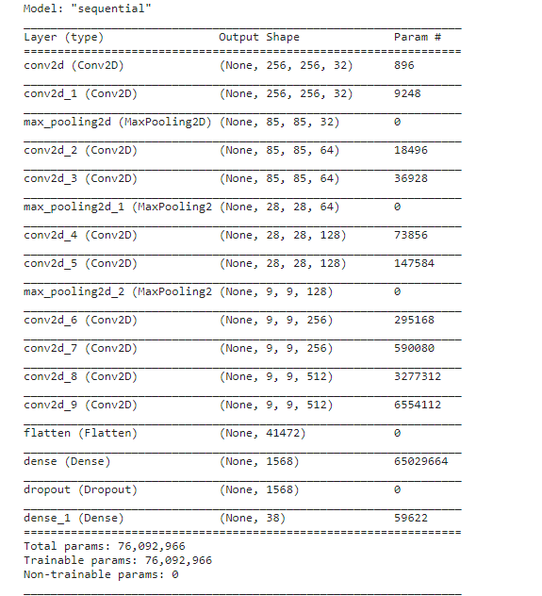
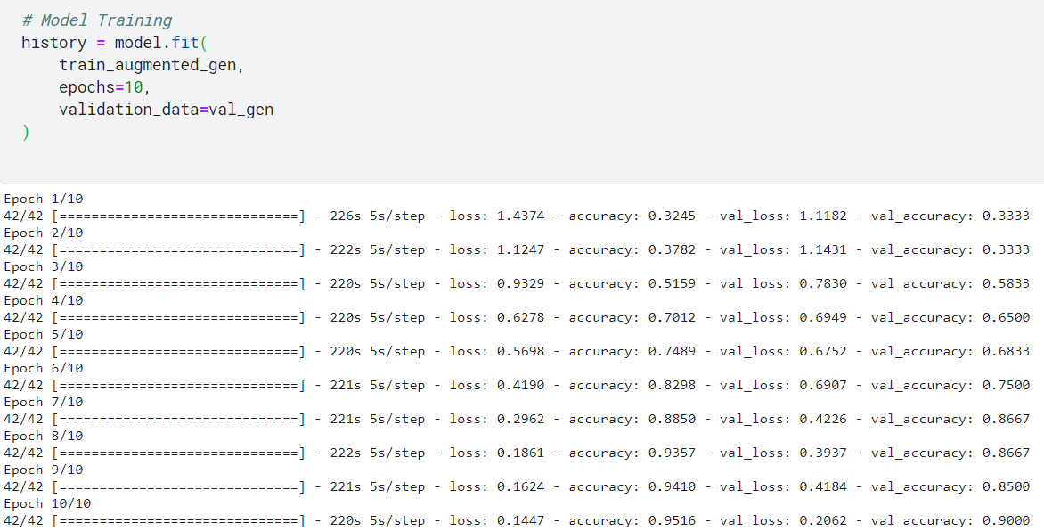
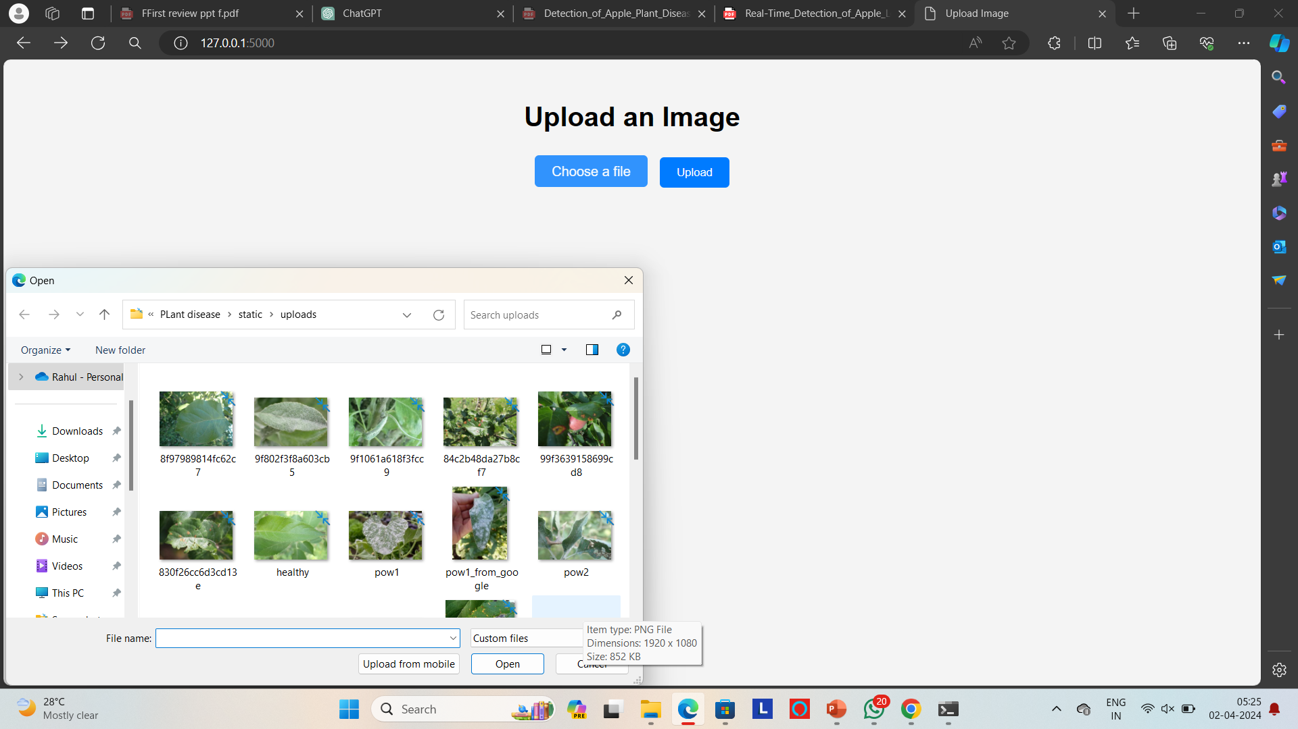
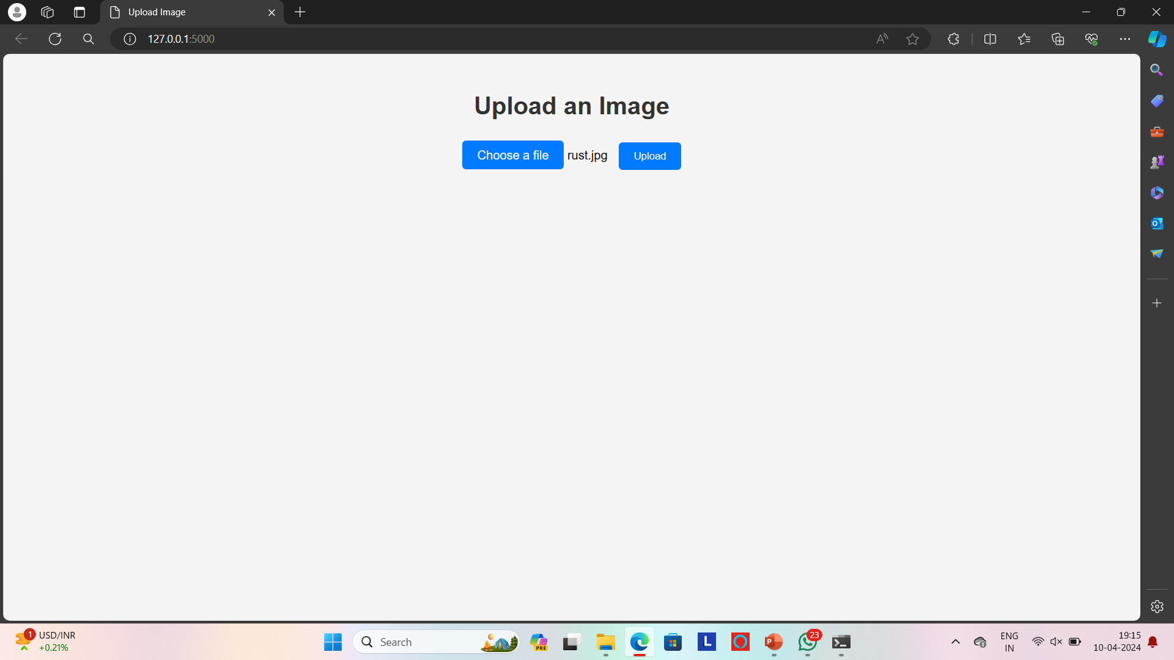
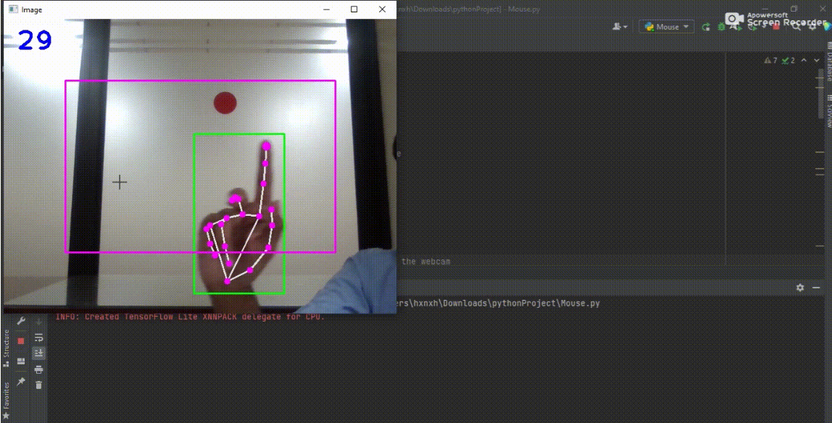
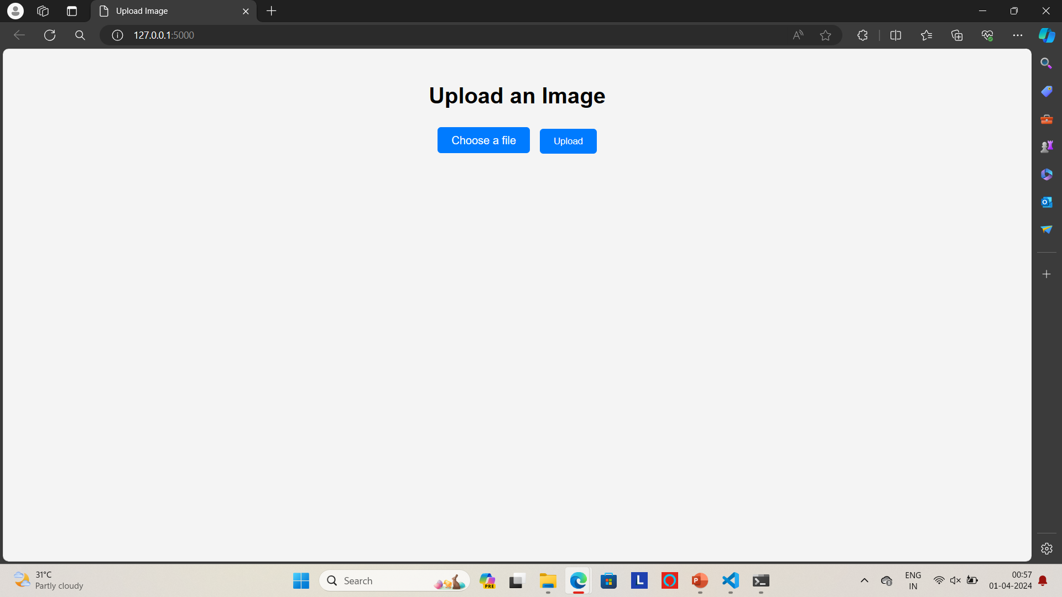
RESULTS OBTAINED
Fig 8. Model architecture image.

Slide 47
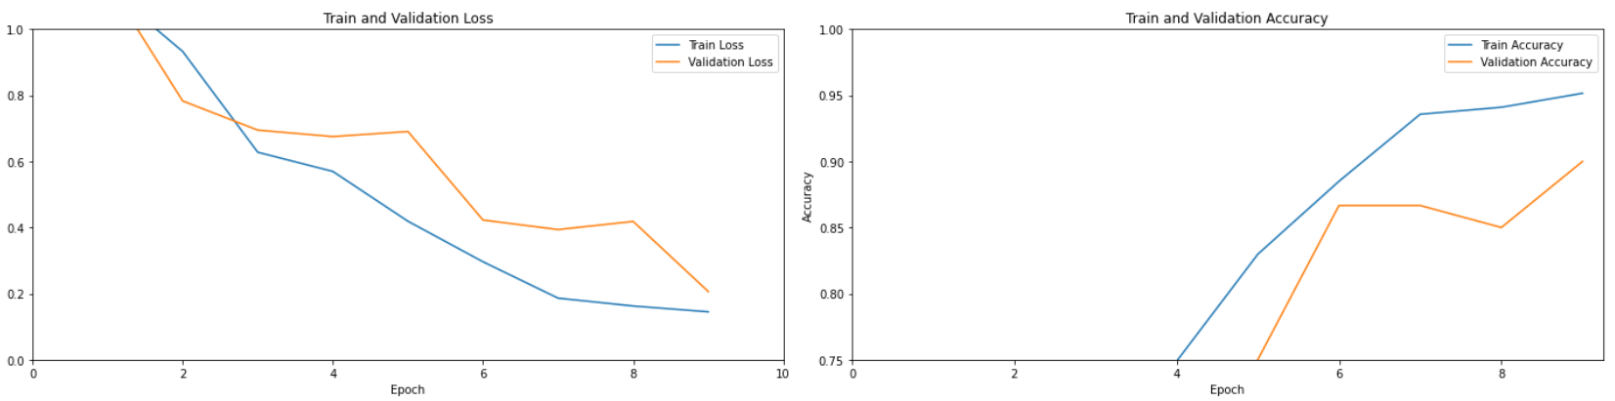
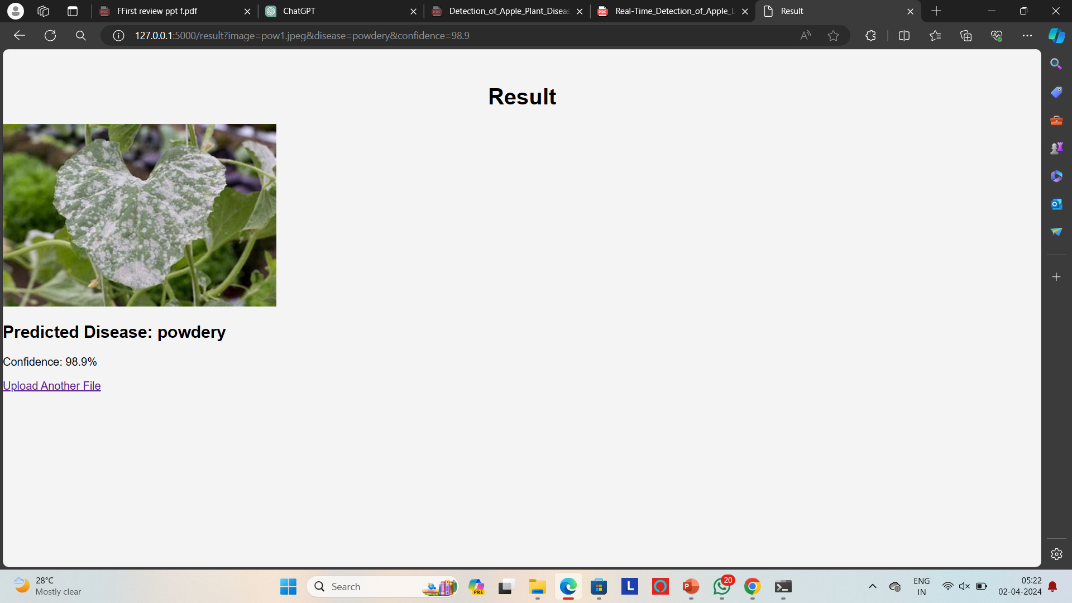
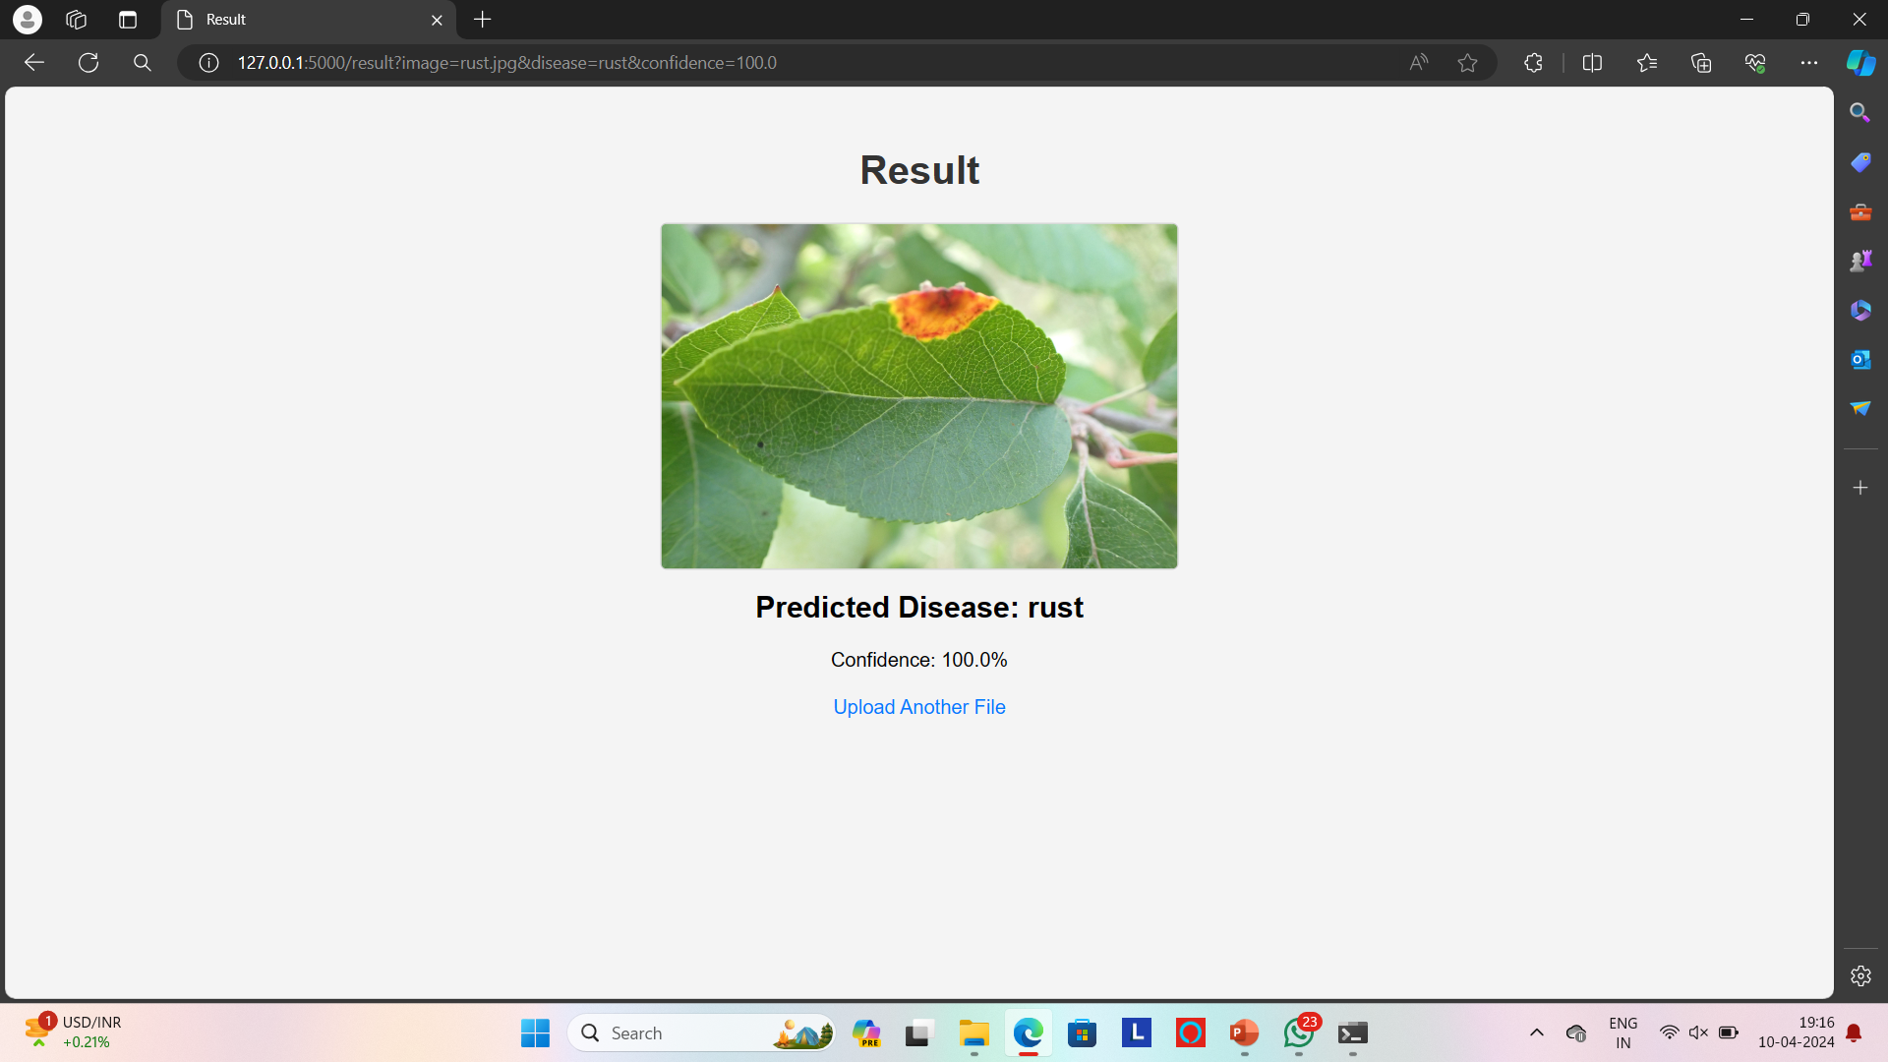
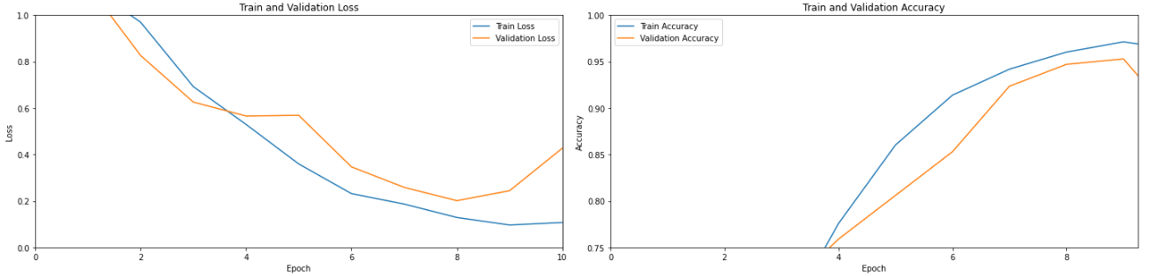
RESULTS OBTAINED (CONTD.)
Fig 9. The graphical representation of the models accuracy during training.

Slide 48
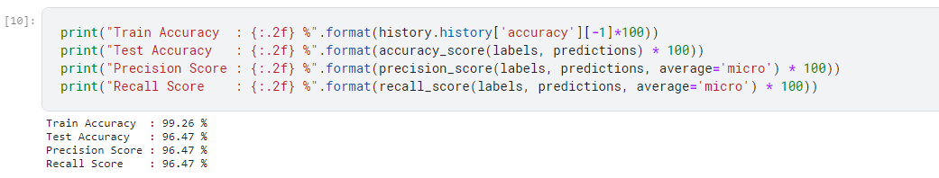
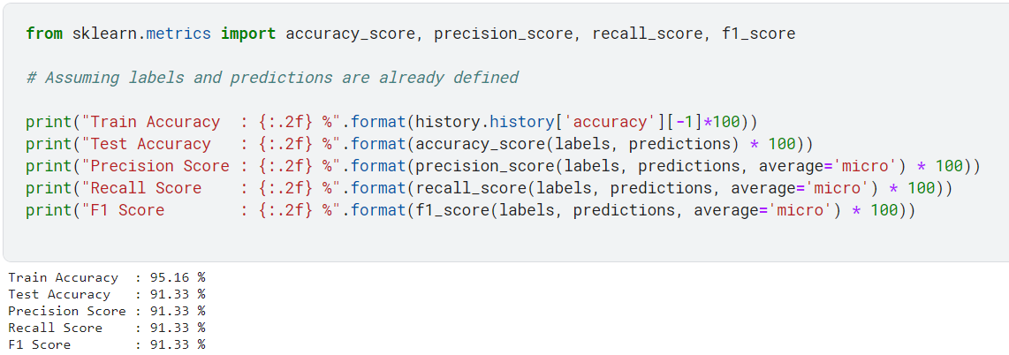
RESULTS OBTAINED (CONTD.)
Fig 10. The performance metrices output .

Slide 49
CONCLUSION
CNNs revolutionize agricultural disease detection, offering accurate, automated solutions for fungal infections in plant leaves. Their efficiency enables early intervention, improving crop health. Further advancements in dataset diversity and technology integration promise even greater agricultural impact, ensuring sustainable food production.

Slide 50
REFERENCES
[1] Vibhor Kumar Vishnoi, Krishan Kumar, Brajesh Kumar, Shashank Mohan, Arfat Ahmad Khan (2023) ‘Detection of Apple Plant Diseases Using Leaf Images Through Convolutional Neural Network’, IEEE Access Vol.11.
[2] Lili Li, Shujuan Zhang, Bin Wang (2021) ‘Plant Disease Detection and Classification by Deep Learning - A Review’, IEEE Access Vol. 9.

Slide 51
REFERENCES
[3] Peng Jiang, Yuehan Chen, Bin Liu, Dongjian He, Chunquan Liang (2019) ‘Real-Time Detection of Apple Leaf Diseases Using Deep Learning Approach Based on Improved Convolutional Neural Networks’, IEEE Access Vol.7.

